Slide 1
KOKOPoint Controller Upgrades
Team Members:
Isaac
Charlene
Brian

Slide 2

What is controller
Controller refers to the firmware code that’s responsible for managing and reporting on the hardware components of the KOKOPoint
Initially written in Arduino, recently converted to C++
All android app interaction with the hardware happens through the controller.

Slide 3
Project Objectives
Secure serial communication link
Implement error detection in serial communication
Simplify the current controller api
Improve controller development and release process

Slide 4
1. Secure communication channel
KP to authenticate itself with the controller before communication
Use of pre-shared auth tokens and nonce
Controller will grant a session for future communication
Defined message format

Slide 5
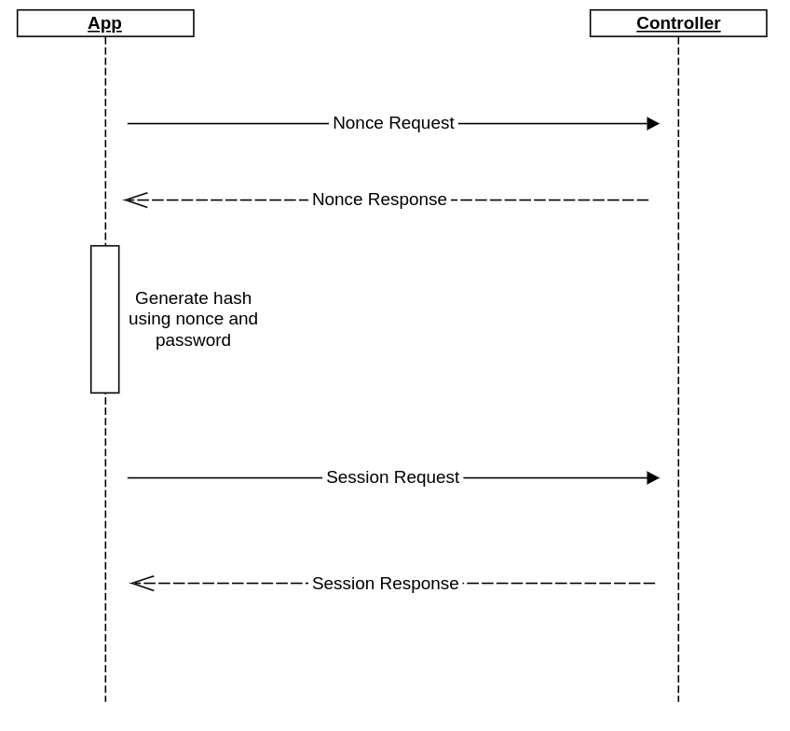
1. Secure communication channel - The process

Slide 6
2. Error Detection
Checking for bit errors in the communication link between app and controller.
Use of CRC32 algorithm to detect the errors.

Slide 7
3. Simplify API
Use shorter messages for api messages
String operations are expensive, hence need for optimization
e.g
- dispense_vol 2000 12411 9500 → dvo 2000 12411 9500
- open_for_refilling → opr
- alert ID:4000000001;AC:055;AD:Problem with main door latch while when door latch was open.
→
ev 4000000001;055;Problem with main door latch while when door latch was open.

Slide 8
4. Improve development and release process
Refactor to an OOP structure, allows for faster feature improvement and debugging
Improve on the controller test case suite to make it as exhaustive as possible.
Integrate automatic code quality checks to the CI process - cppcheck

Slide 9
Project Objectives
Recap..
Secure serial communication link
Implement error detection in serial communication
Simplify the current controller api
Improve controller development and release process

Slide 10
Brian
Thanks for listening!

